Slide 1

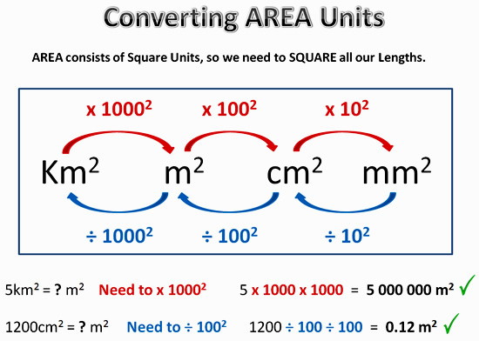
My Measurement Interactive Notebook
1

Slide 2
Contents
Glossary or Formula Page
Page
Date
Description
2
3

Slide 3
Tasks
24
7
30
Essential Question
Questions
Notes
Summary
6
7

Slide 4
Activity- Estimation
What AREA units would you use for the following:
Your desk
Baldivis
Your fingernail
The classroom
The school grounds
cm²
km²
mm²
m²
m²

Slide 5
Let’s try creating some quadrilaterals
You need a piece of paper, a PENCIL, some scissors and a ruler
Mark the top left corner of your page with a VERY small ‘A’. Move across the top of your page, placing a small dot every 5cm. Do the same thing along the bottom edge and then make vertical lines to join these dots up.
You should be left with a 1cm strip down the right hand edge. Cut this off.
Now go down from ‘A’, once again placing dots every 5cm, and mark the bottom left corner with a ‘C’. Do the same on the other side but instead of the A and C, mark a ‘B’ halfway down your page. Join the dots with horizontal lines.
(The last 5cm is out by 3mm. Oh well.)
Finally draw a line from A to B and cut along this line. Repeat the process from B to C. You should be left with 3 triangles!

Slide 6
What quadrilaterals can you make?
Make as many quadrilaterals as you can and identify what they are called. You can make more than one of a certain type but they must not be congruent.
You can flip the triangles over and you don’t have to use all the triangles. No overlapping!
Mr H can make 8. Can you beat him?!?!

Slide 7
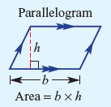
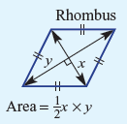
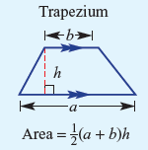

24
7
30
Date
Area
EQ – How do we calculate the area of basic shapes?
What are the formulas for the area of special quadrilaterals?
5

Slide 8
But do they even work?
The formula for a parallelogram is the same as rectangle. Use your triangles make a parallelogram and prove the formula is correct.

Slide 9
But do they even work?
A rhombus is a special parallelogram with all equal sides and equal opposite angles. Use your triangles make a rhombus and prove the formula is correct.

Slide 10
But do they even work?
Two trapeziums can be made, a regular (symmetrical) and an irregular (asymmetrical) trapezium. Use your triangles make these two and prove the formula is correct.

Slide 11
But do they even work?
To prove the kite we need to use a ruler (unless we get help from our Yr 9 friend: Pythagoras. l Use your triangles make a kite and prove the formula is correct.

Slide 12

Great success?
Notes:
Check for Understanding

Slide 13

Your Turn
Turn to page 233 in your Dwyer Book and complete Exercise 17.5 and 17.6
Left Hand Side

Slide 14
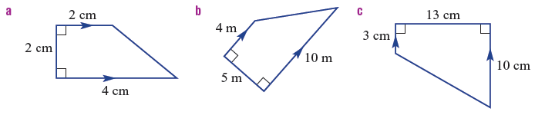
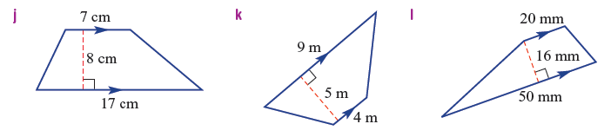
…and trapeziums!
Find the area of these trapeziums

Slide 15
Notes Review
24, 7 ,30
Date
Title
Essential question
Notes complete
Notes complete with colour and diagrams
Questions completed
Contents page filed in
Formula page filled in

Slide 16
Homework
Review your notes and write a summary answering the essential question.

